Slide 1


USMC Aviation Fly-Over Brief
Notes:
Welcome to the USMC Aviation Fly-Over brief. You have been granted the honor and responsibility to represent the United States Marine Corps in a public forum. It is an honor to display to the citizen’s we defend the capabilities of Marine Aviation. With that honor comes the responsibility of maintaining the public’s safety and adhering to all applicable orders and directives. Unfortunately there is no one-stop shop to find all the information you need to successfully plan and execute a fly-over. This brief will help you with your mission preparation and flight planning. It will guide you through a list of contacts, where to look for guidance, and will allow your flight to be conducted within the bounds of all applicable directives and publications. As Marine aviators we pride ourselves every flight with detailed planning and execution to support the GCE to the best of our abilities. It can be very tempting to display that pride to the public with the best of intentions in order to demonstrate the capabilities of our platforms. In 2009 I led a night fly-over in Miami for an NFL game. Despite close coordination with ATC and verbal FAA approval I broke the no-lower-than altitude prescribed by HQMC, the FAR part 91, and night systems training rules. Please take the time to absorb the lessons in this brief to learn from my mistake and make your fly-over safe, successful and rewarding to both the public and the participating aircrew.

Slide 2
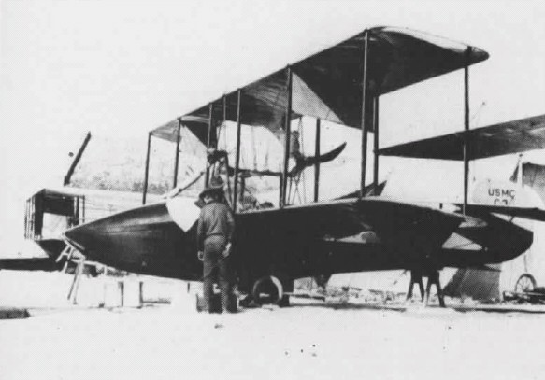
Purpose
More fly-overs due to centennial
FAA reporting increase
Prevent flight violations
Notes:
Beginning in January 2011 the number of fly-over’s being requested will increase due to Naval Aviation’s Centennial. The Navy Marine Corps website for Centennial Celebration states that there will be increased support at major events to highlight the history, prestige, and legacy of Naval Aviation over the past 100 years. Over the past two years, the FAA has increased their scrutiny and increased their volume of requests for investigations into suspected flight violations. This is due to a mandatory reporting process required by the FAA now in the interest of safety. In the past, the FAA could call the Regional Marine Corps NAVREP, who would handle misunderstandings at a very low level. The offices for the regional reps can be found in OPNAVINST 3700.2K, appendix B. As it stands now your command will be required, at a minimum, to conduct a command investigation into any reports filed by the FAA. The bottom line for this brief is to arm you and the aircrew who have been tasked for your fly-over event with the tools necessary to conduct your fragged event safely, effectively, and within the boundaries of all applicable publications, directives, and orders. At a minimum, this will help build an operating envelope for you as you conduct this event.

Slide 3
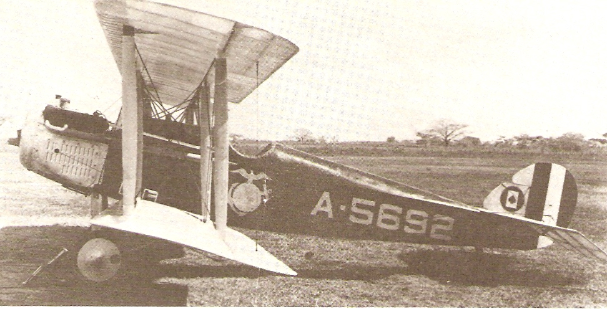
References
FAR Part 91
Section 91.115 & 91.117
No lower than 1000’ above any obstacle
No faster than 250kts
Training rules
T&R Vol 1
Less than .0022 LUX at night, no lower than 1000’ AGL
Approval Message Traffic
OPNAV 3710
MCO P5720.73
Page 2-4
WX min = 2500’AGL / 5NM visibility
Profile = 1000’ AGL above highest obstacle / 250 kts max without waivers
Bottom line:
1000’ AGL & 250KTS
Notes:
There are multiple sources for guidance on the conduct of fly-overs. Keep in mind that no matter what anyone tells you, approves for you, or says over the radio, what is written down in black and white is the absolute truth! MCO P5720.73 is the MCO for fly-overs and air show support. Inside you’ll find guidance for requests, etc, but what I want to point out is on page 2-4; this states the minimum weather 2500’ and 5NM, as well as no-lower-than altitudes. We’ll talk specifically about these in two slides but the limits of what you can do are clearly spelled out. If you remember nothing else from this brief, remember this: 1000’ AGL and 250kts. That goes for every single T/M/S in the Marine Corps inventory. No matter what happens or fails to be coordinated, that will keep you inside all rules and directives. With that being said the FAR part 91 states that it shall be 1000’ above the highest obstacle. You’ll have to take a look at what you are flying over. If it’s a parade at sea level, then 1000’ AGL should be safe. However, if you’re tasked to fly-over the new Cowboys Stadium, you will discover that the stadium reaches up to 292’ ft. So, your no lower than altitude would be 1300’ AGL. Also keep in mind that the stadium sits at approximately 600ft MSL, so your no lower than MSL altitude would now read 1900’ MSL.

Slide 4
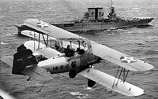
Mission Analysis
Type of request
Sporting event
Military celebration
Funeral
DD 2535 is first step
The request for the fly-over
Notes:
Once you’ve been tasked to conduct your fly-over you need to figure out exactly what the mission is. You’ll find a lot of this information, to include valuable points of contact within the DD Form 2535. The 2535 is the actual form from the public event coordinator who had to fill out the request for the fly-over. It’s more than just a request; it may tell you exactly the profile requested, why it’s being requested, and may help point you towards any waivers which have been requested. A fly-over is a support mission, so it’s important to try to give the requestor on the form 2535 exactly what they desire, but needs to be executed within the boundaries of all directives and orders. Is it a sporting event? This will probably require a timing problem of some sort. Is it a funeral? Then it may request a missing man formation. Of note, missing man formations are ONLY authorized via the approval message (more on that in two slides) and will only be granted during funerals. The point is that fly-over’s come in many shapes and sizes.

Slide 5
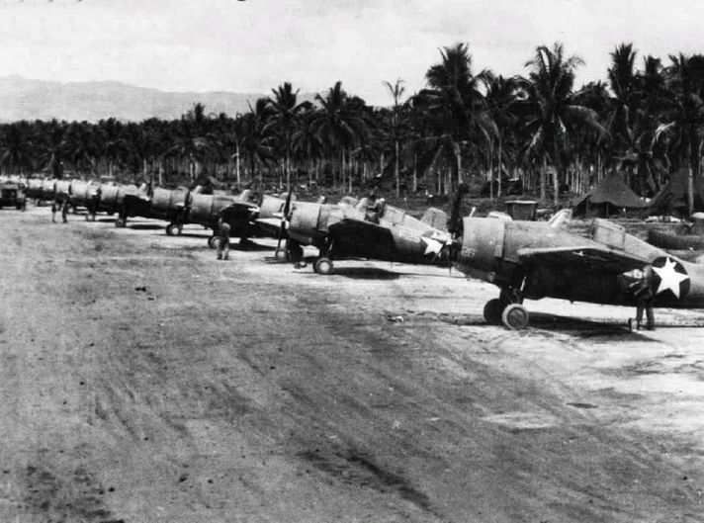
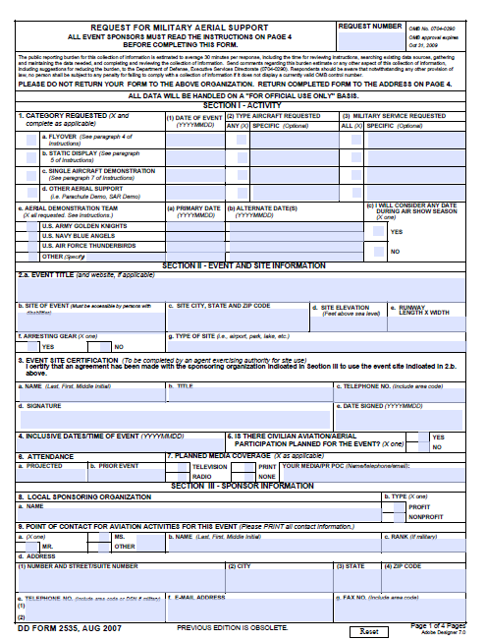
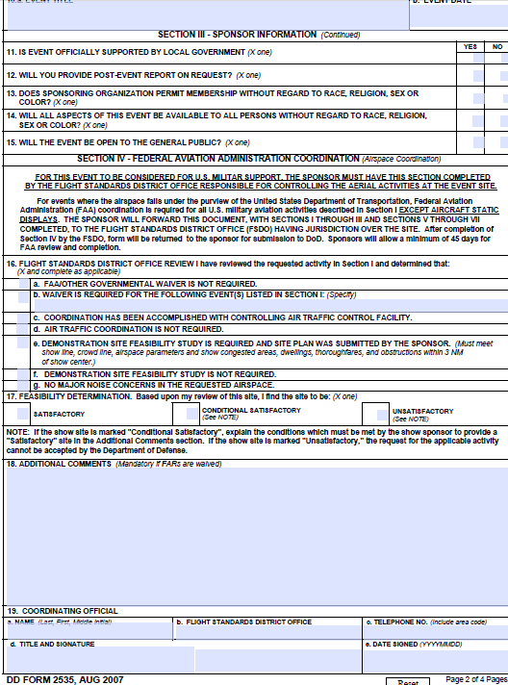
DD 2535
Notes:
Here is a DD form 2535. The first two pages hold the most pertinent information. Section 1 will spell out the TMS for the event, and when the event will occur. Section 2 will detail why the event is being held and if it is at an airport, the airport specifics. Section 9 will list POC’s for the event. It will have the actual event coordinator and will most likely also have at least one FAA representative. On page two, section 16 lists information about waivers; have they been requested, when were they submitted, or even if they are allowed at all. These are the highlights of this form, but each and every block has valuable information.

Slide 6
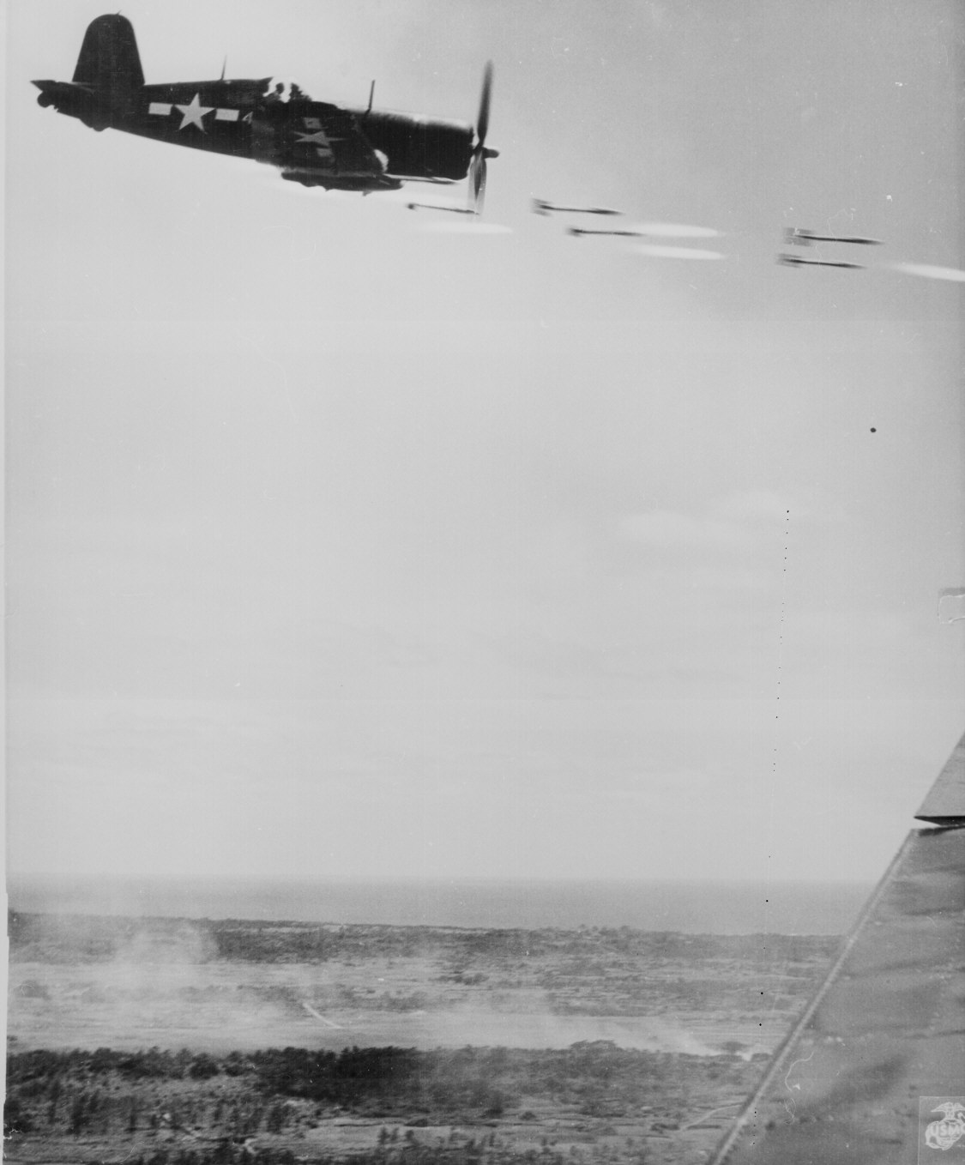
HQMC Approval
UNCLASSIFIED// MSGID/GENADMIN/CMC WASHINGTON DC AVN ASM// SUBJ/ACFT SUPPORT FOR PUBLIC EVENT ISO COMMARFORCOM// REF/A/MSGID:MSG/COMMARFORCOM G3-5-7/102031ZSEP2009// REF/B/MSGID:DOC/MCO P5720.73/YMD:19960806// REF/C/MSGID:DOC/OPNAVINST 3710.7T/YMD:20040301// NARR/REF A IS COMMARFORCOM REQUEST TO SUPPORT AN ELIGIBLE EVENT. REF B IS THE MARINE CORPS AVIATION SUPPORT OF THE COMMUNITY RELATIONS PROGRAM MANUAL. REF C IS NATOPS GENERAL FLIGHT AND OPERATING INSTRUCTIONS.// POC/PERRY/CPL/UNIT:HQMC ASM-51/-/TEL:DSN 227-2401 /TEL:COM (703) 697-2401/EMAIL:LEAH.PERRY@USMC.MIL// GENTEXT/REMARKS/1. PER REF A, AND IAW REF B AND C, AUTH GRANTED TO EXECUTE THE FOLLOWING: EVENT: SUN CITY VETERANS ASSOCIATION WALK FOR THE WOUNDED DATE: 11 SEP 09 LOCATION: BLUFTON, SC AIRCRAFT: (2) F/A-18C UNIT: VMFA-251 SPT TYPE: FLYOVER RMKS: FLYING UNIT MUST COORDINATE WITH LOCAL FAA AND FSDO, POC ROBERT JENKINS, COMM (803)451-2665. 2. FLY BY SHALL BE STRAIGHT, LEVEL, AND NON-MANEUVERING. MISSING MAN FORMATION IS NOT AUTHORIZED. 3. PER REF C, EXCEPT WHEN NECESSARY FOR TAKEOFF OR LANDING, NO PERSON MAY OPERATE AN AIRCRAFT BELOW 1000 FEET ABOVE THE HIGHEST OBSTACLE WITHIN A HORIZONTAL RADIUS OF 2000 FEET OF THE AIRCRAFT OVER ANY CONGESTED AREA OF A CITY, TOWN, OR SETTLEMENT, OR OVER ANY OPEN AIR ASSEMBLY OF PERSONS. PER REF B, IF THE FAA GRANTS A CERTIFICATE OF WAIVER BEFORE THE EVENT WHICH SPECIFIES A LOWER MINIMUM ALTITUDE, ROTARY WING AIRCRAFT, TO INCLUDE MV-22, SHALL NOT BE FLOWN BELOW 500 FEET AGL, FIXED WING SHALL NOT BE FLOWN BELOW 800 FEET AGL. 4. DIRLAUTH ALCON FOR COORDINATION. 5. MARINE CORPS DISTRICTS SHOULD ENSURE RECRUITERS ARE AWARE OF THE ABOVE EVENT IN ORDER TO TAKE FULL ADVANTAGE OF MARINE CORPS PRESENCE AT THEIR PARTICULAR LOCATION. 6. POC'S: A. MGYSGT CAMPOS (HQMC PA), COMM (703) 614-1034 B. CPL PERRY (HQMC ASM), DSN 227-2401 COMM (703) 697-2401
What, where, when, how many & type of AC
You MUST contact this person!
A reminder of FAA Rules; but sets the floor at 1000’ AGL
Hugely important!! “with a waiver” sets your min alt RW & V-22 = 500’: FW = 800’, again if you have a waiver!
Notes:
There MUST be approval from HQMC. This will be posted on the AMHS (Advanced Message Handling System) website. Find this to continue your coordination. Here is an actual approval message from HQMC. There are many important pieces of information contained herein. First, it states where, when, T/M/S, how many aircraft are expected. Once this message hits the message board you are now required to support. Coordinate with your OPS and maintenance to ensure you don’t fail to show up for your fragged event. Second, a POC is listed with whom you are directed to make contact with. Call them and ensure to record who, when, and what was discussed and likewise save every e-mail you send or receive. Third and fourth are of monumental importance - the third highlighted box sets your floor at 1000’ AGL, applicable to both RW and FW aircraft. Fourth, it goes on to say that “with a waiver” RW & tilt-rotor can go to 500’ AGL and FW can go to 800’. In order to have an approved waiver, you’ll need to submit Form DD 7711-2 for no lower than 500’ (RW) or 800’ (FW) 45-60 days prior to the event. Due to the time constraints required for a waiver, most likely you’ll be planning for the assumption of 1000’ AGL and 250 kts. Also, keep in mind that this message will typically not include airspeed restrictions – those are dictated by FAR Part 91. You are probably very comfortable flying at 300kts for FW around your local airfield, whether it be Cherry Point or Yuma. Your base most likely has a MOA with the local FAA to allow for that. Most civilian airports (in particular class B airspace) do not have any waiver with the military for airspeed, so 250 kts is your max. In addition MCO 5720.73 states that with approved waivers, single ship RW can go to 250’ AGL and FW can go to 500’ AGL. Again, this is above the highest obstacle. But you’ll note this example approval message is more restrictive than the MCO 5720.73. Regardless, you must go with the most restrictive, be it an approved waiver to that listed in the MCO, the approval message, or FAR Part 91.

Slide 7
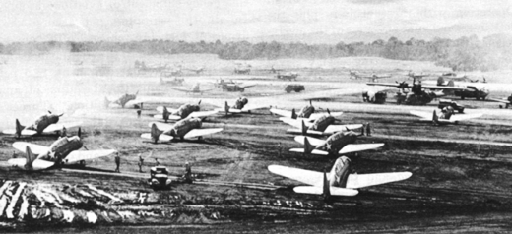
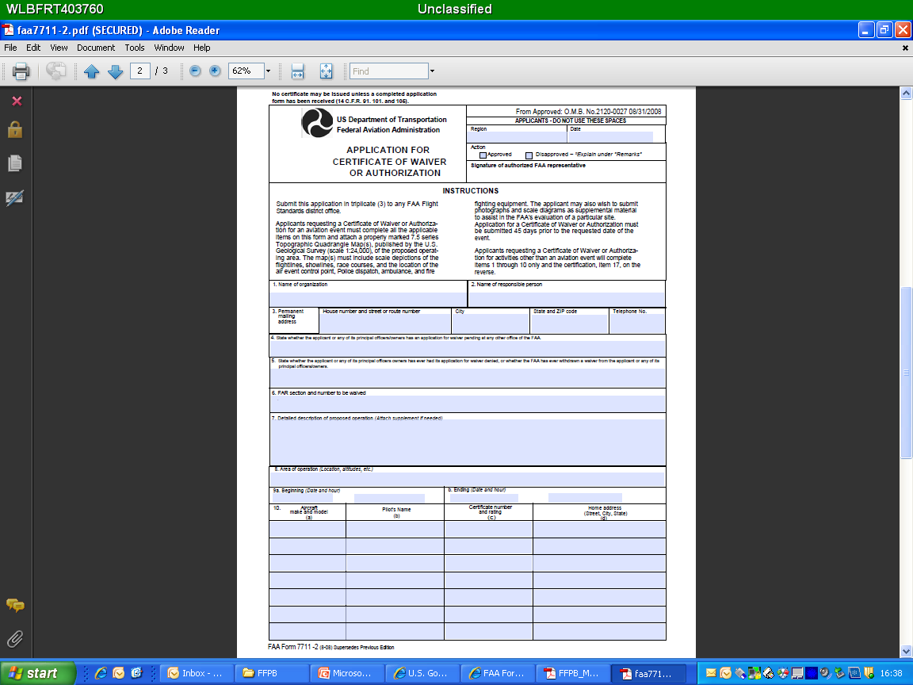
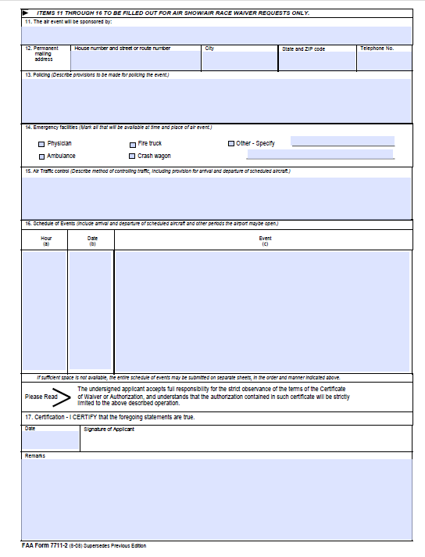
Waiver DD 7711-2
Notes:
This is the DD form 7711-2. It is what you need to have submitted to the FAA 45-60 days in advance in order to get a lower altitude. Even if this waiver is approved by the FAA, the approval message from HQMC may dictate a higher altitude. You’ll note that on the previous slide, it stipulated 800’ AGL with a waiver for FW. If your waiver was granted for 700’ AGL, even if you are a single ship you still can only go down to 800’ AGL, above the highest obstacle.

Slide 8
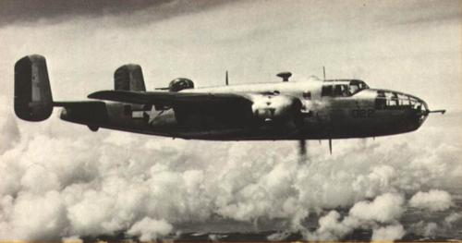
Coordination
Simultaneously contact
Event POC
Found in the DD form 2535
Regional FSDO
http://www.faa.gov/about/office_org/field_offices/fsdo/ for the area of your event
Regional Military Representative
OPNAVIST 3007.2K, APPX B
Approach controller or suitable ATC rep
http://www.faa.gov/about/office_org/headquarters_offices/arc/ro_center/ to navigate to regional rep
Cannot authorize deviations to the FAR, OPNAV, or HQMC guidance
Notes:
In the case of fly-overs, coordination means you’re going to have to call and e-mail a few outside agencies. The following list is not all inclusive. Obviously, call the POC who is in charge of the event. They may have past experience with fly-overs for that area or event and can provide you with some good local information. They may also have a specific profile they wish you to fly; i.e. coming in from a certain direction, a time window to be overhead, etc. Next, call the regional FSDO (Flight Service District Office). You can look it up online and go to their applicable website, and the local one for your event is listed in the HQMC approval message. Next, get in touch with the local FAA rep. This person will be helpful in ensuring the FAA is aware of the event. They also hold the paperwork for any waivers you may wish to request. You also want to talk to the local ATC or, even better, the actual agency who will be controlling you during the event (Center, Approach or Tower). They can tell you where noise sensitive areas are, any obstacles you’re unaware of, local flying patterns and high traffic areas and you can tell them exactly what your plan of attack is. Also, whomever requested the event from the military has to make a formal submission in the form of the DD Form 2535 – ensure you call and talk to all listed POC’s. As aviators, we are very used to the FAA directing us around the sky, into and out of our airspaces. As you discuss specifics with the POC’s, do not make the mistake of a controlling agency granting you approval for something that is prohibited by either the FAR part 91 or HQMC.

Slide 9
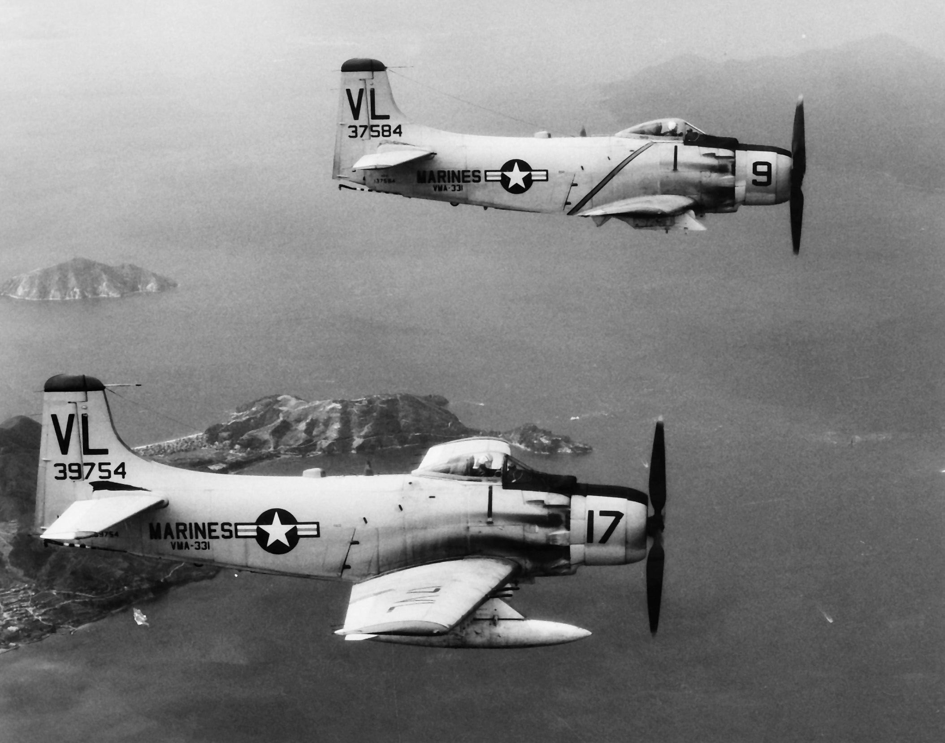
Mission Planning
Where is the target
TOT or VUL window
Holding points
Entry & exit from target
Area Planning
Info on local airports and VFR / IFR routes
BASH
http://www.usahas.com/
FW: Moderate = 1000’AGL; Severe = 3000’AGL
Notes:
Like any mission, we’ll plan from the target backwards. So where is your target? Next, what is required? Is it a TOT or a VUL window you have to meet? In either case this will become the stake from which all other timing is built. This will drive when you have to be in holding, when you have to take-off, taxi, start, walk, brief etc. For the push, for FW, consider 235kts or .4 mach IOT ease the timing problem and provide a little extra airspeed in case you get behind. For RW consider 60 or 120 kts for the same reason. Once you have an idea of which direction to come in from, plot your holding points. Ideally, this is over unpopulated areas and obstacles. You want a big race-track pattern for FW and a sizeable HA for RW to give yourself some freedom of movement. Next, figure out how exactly you’re going to get to your holding area and file accordingly in your DD-175. Typically TACAN cuts are what is required. With detailed coordination with the FAA you can coordinate, name and file these points on your DD-175, but have TACAN cuts ready to go in your cockpit. Apply the same amount of detail to your plan from the target to the destination airfield, which often is in close proximity to the target. This will take significant coordination with the local FAA rep and approach controllers, and is not something that can be done in real-time. Finally, don’t forget to look at the BASH for your target. If it is moderate, FW are restricted to 1000’ AGL, and if it becomes severe you can fly no lower than 3000’ AGL. Instead of a block altitude you’ll most likely end up with a hard altitude to exit the target area and maneuver to your airport.

Slide 10
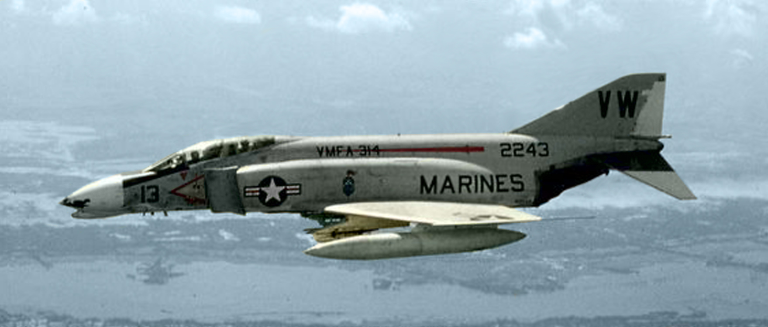
Mission Planning
Plot route
Like a low-level
E-CHUM
Notable avoidance areas
RTB
Detailed plan from target to airfield
Go / No-go
Notes:
Similar to low level planning, plot the entire route, using low altitude charts, from the holding point to your destination. Identify any obstacles, whether they be man made or natural. Click the e-chum button on your JMPS computer to plot any towers and keep in mind that most tall towers have guide wires protruding from them. Also, use JMPS or the FLIP AP-1B to determine if any low-level’s intersect your route. This can provide you with some insight as to where documented noise-sensitive areas are. You can also see if there are any MOA’s, co-use, or warning areas anywhere near your route, which may mean getting approval from a controlling agency, or deconflicting your route. Finally, you’ll want to determine the go / no go criteria. We’ve already seen we are restricted to a 2500’ AGL/ 5NM weather restriction at a minimum. You may want to raise this depending on the terrain, obstructions or location of the event. Have a drop dead time in case you have to slide to the right. If approach asks if you can go lower than 1000’ for “traffic avoidance” you must abort. Do not accept anything that will put you outside of the acceptable parameters. We’ll build one in two slides.

Slide 11
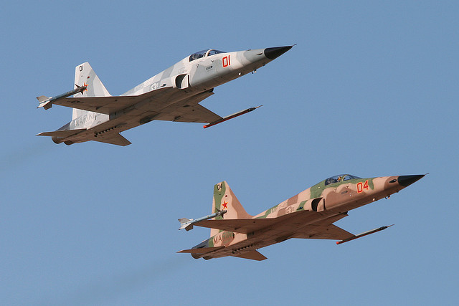
Briefing
Your command
HHQ
Your flight
Record everything
De-brief
Flight
FSDO / FAA
Notes:
With planning complete, you’ll most likely be required to brief your chain of command in some fashion. You will need to spell out in detail your scheme of maneuver and whom you have contacted. Think of it like a mission commander brief. Start with the overview, brief your admin; where you’re taking off from, when, where you’ll be landing, PPRs required, security available at that location, who is in the flight, etc. Next brief the mission itself; where you’re holding, the route itself, the entry and exit plan, obstacles, your C3 plan for that portion, etc. Pictures and imagery will be very helpful to support your plan. Additionally, you will need to brief your proposed altitude and airspeed. You’ll need to have official, signed waivers in hand authorizing you to be lower and / or faster than 1000 feet / 250 kts, as applicable. You’ll also need to mention the 2500’ / 5NM weather minimum. If anything changes after the chain of command has been briefed, then you need to update the chain of command.
For your actual mission brief, in addition to your normal NATOPS brief, have charts for all aircrew to ID potential hazards you have uncovered in mission planning. Figure out what formation you’ll be in - echelon, diamond, etc. Have a plan for what you are going to record; depending on your T/M/S, use your systems to ensure any and all radio transmissions and aircraft profile is recorded. If your T/M/S allows for it, deconflict within the flight what is recorded, i.e. one aircraft can record HUD video, while another can record the moving map at the lowest scale. When the flight is over, save the flight’s tapes and consider having your S-2 digitize and save the data. If there is some sort of noise complaint, or alleged deviation, recorded evidence will hold significantly more weight than aircrew statements months after the fact. Post landing, conduct a thorough de-brief, focusing on safety of flight, the flight profile, and if there were any potential deviations from the plan. When you return to your squadron, contact the FSDO / FAA rep you had coordinated with and ask if they saw any issues during the actual event. Document that you called / e-mailed that person and anything they say. Further, if FAA ever alleges a deviation, OPNAVINST 3710.7 prohibits aircrew from providing aircrew names to the FAA.

Slide 12
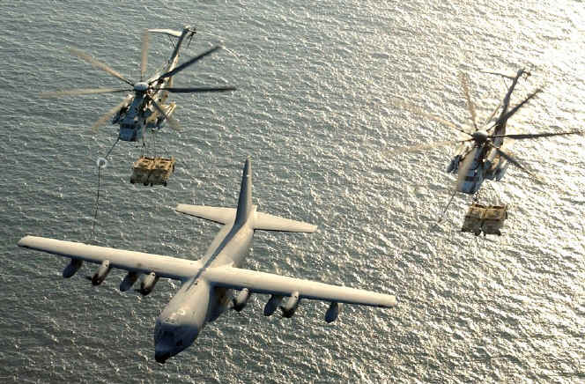
Your Checklist
DD Form 2535
HQMC approval message
Call / e-mail FAA / FSDO reps
Call / e-mail event coordinator
Conduct your planning
Brief everyone up the chain
I000’ / 250kts
Notes:
As a quick review, let’s go over a quick checklist of things you need to accomplish:
Get the DD Form 2535. Don’t forget it’s the request message from the event coordinator asking for your fly-over. It has great info on the requested profile, any waivers that have been submitted, and points of contact.
Get the HQMC approval message. It will have the FSDO rep listed, and further restrictions to your profile.
Begin coordinating with the FAA and FSDO reps. Document everything; every phone call, save every e-mail, and FAX, etc. Talk to your controller if you can, in to work out flight details and so that the appropriate ATC agency is aware of your intent when you show up.
Call the event coordinator. They will tell you what they’re looking for. Ultimately, this is who you are supporting for this mission, so try to accommodate within the bounds of all publications and directives.
Conduct your own flight planning. Again, your mindset should be planning a flight school low level.
Brief the chain as required and down the chain (your flight). The more communication you have across all boundaries the better off you’ll be.
Always remember 1000’ ft and 250kts. If anything, you want to be more restrictive than this. If somewhere along the line a lower altitude or faster airspeed becomes available, then the red flags need to come up and you need to be extremely careful about it.

Slide 13
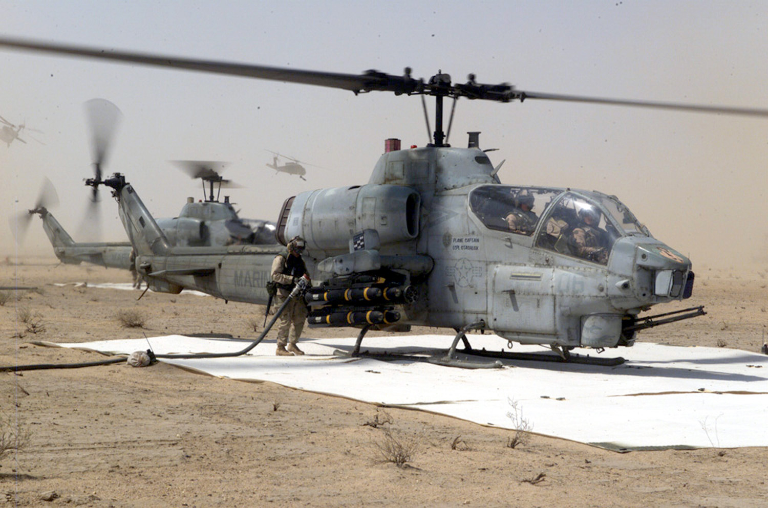
Wrap Up
250 kts MAX
2500’ AGL WX Min
Approval message
Coordination
Mission Planning
Checklist
The Box
Optimal plus obstacle elevation
1000’ AGL FW & RW (FAA & HQMC)
800’ AGL FW formation waiver NLT (HQMC)
500’ AGL single ship FW waiver NLT or RW formation NLT (HQMC)
250’ AGL single ship RW waiver NLT (HQMC)
Notes:
We covered a lot of information here. We went over some pubs and directives, the request & approval messages, the mission planning & coordination required, and finally a nice checklist for you to use. You’ll see that the “box” built by all of these rules is somewhat small, but can still be effective for your mission. Next to each altitude is where that altitude originates from. The optimal place to put your flight is 250kts or less, and 1000’ AGL or higher over the highest obstacle. If the weather comes down below 2500’ AGL, then you need to abort. Regardless of your T/M/S, this will ensure you are in compliance with all directives and orders.

Slide 14
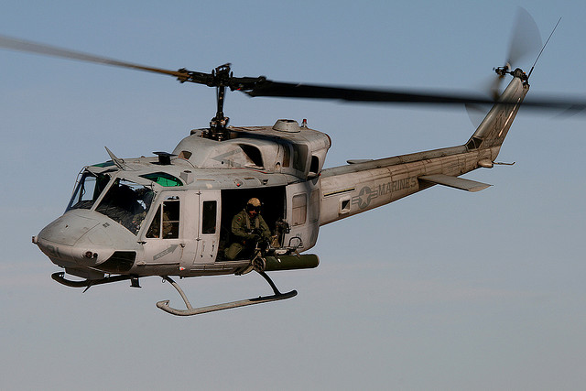
Questions? Contact your MAG OPS & DSS
Notes:
If you have any questions about anything contained in this brief, please contact your MAG OPS & DSS. They will be able to help solve any issues you come across. Good luck with your fly-over. Once you click to the next slide you’ll find a certificate of completion. Print this out and ensure every member of your flight has reviewed this brief.

Slide 15
USMC Aviation Fly-Over Brief Completion Certificate
This brief has was viewed in it’s entirety.
Name
Date
Notes:
(When incorporated to the website, auto-populate name and date for printing)

